Slide 1

Designing IOT application
Vishal Khatal
https://vishalkhatal.wordpress.com/

Slide 2

Agenda
What is IOT Application?
Device Connectivity
Understanding the Azure IoT Suite
Pre-configured IOT solutions
Demo

Slide 3
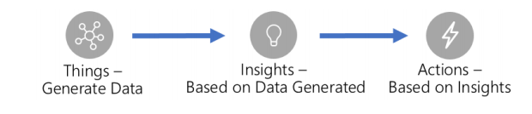
What is an IOT application ?
Notes:
https://docs.microsoft.com/en-us/azure/iot-hub/iot-hub-create-through-portal

Slide 4
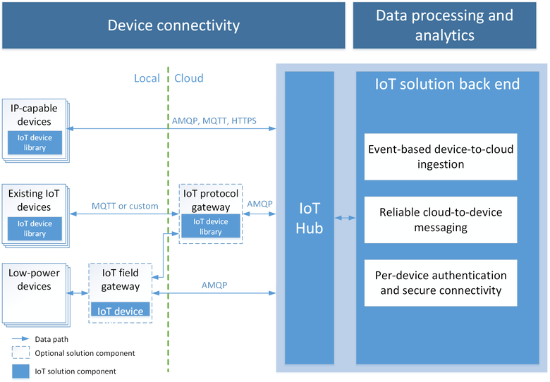
Device Connectivity
Notes:
https://docs.microsoft.com/en-us/azure/iot-hub/iot-hub-create-through-portal

Slide 5
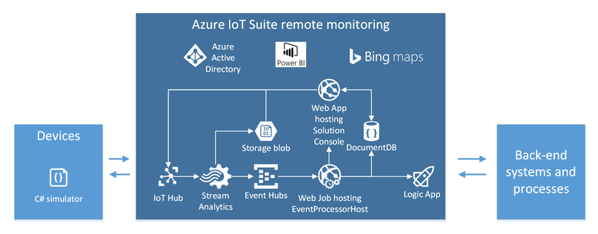
Understanding the Azure IoT Suite
Notes:
https://docs.microsoft.com/en-us/azure/iot-hub/iot-hub-create-through-portal

Slide 6
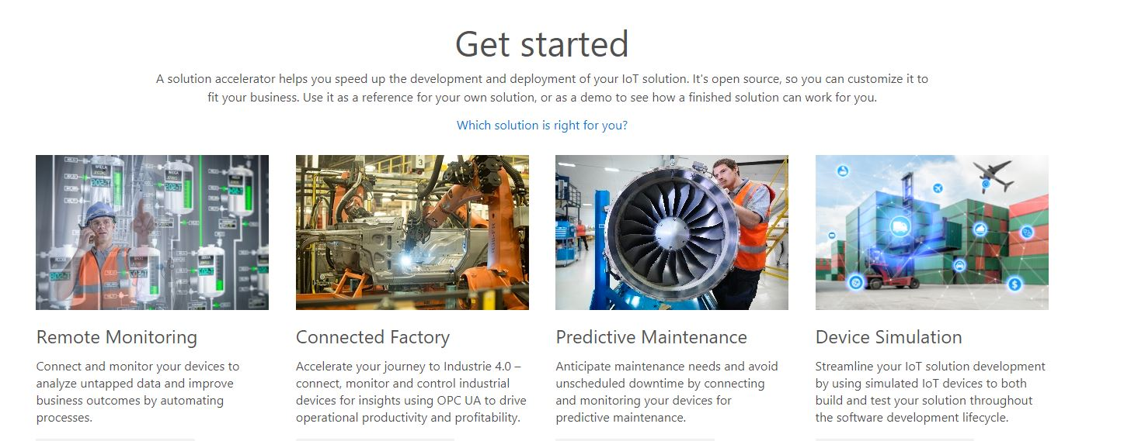
Pre-configured IOT solutions
Notes:
https://www.azureiotsolutions.com/Accelerators

Slide 7



Demo
Device Simulator
IOT Hub
Web Job
Take Action
Source code is available here : https://github.com/vishalkhatal/Azure-IOT/
Notes:
https://www.azureiotsolutions.com/Accelerators

Slide 8
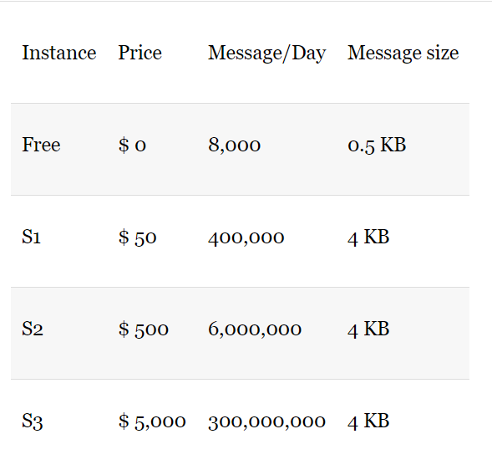
IOT Hub
Pricing
Device identity and registry
Device-to-cloud and cloud-to-device communication
We can query the device store information.
Monitoring for devices and messages
Notes:
https://docs.microsoft.com/en-us/azure/iot-hub/iot-hub-create-through-portal

